Slide 1
STAFF ADVISORY COUNCIL BOOTH
Virtual Benefits and Wellness Fair 2020

Slide 2
The mission of the Council is…..
To serve as an advisory group to suggest, comment, and provide feedback on policies and raise awareness of issues that affect the University and the people it serves
To establish and maintain a forum for communication between University staff and administration on all levels
To establish and maintain a forum for communication among staff at the University

Slide 3
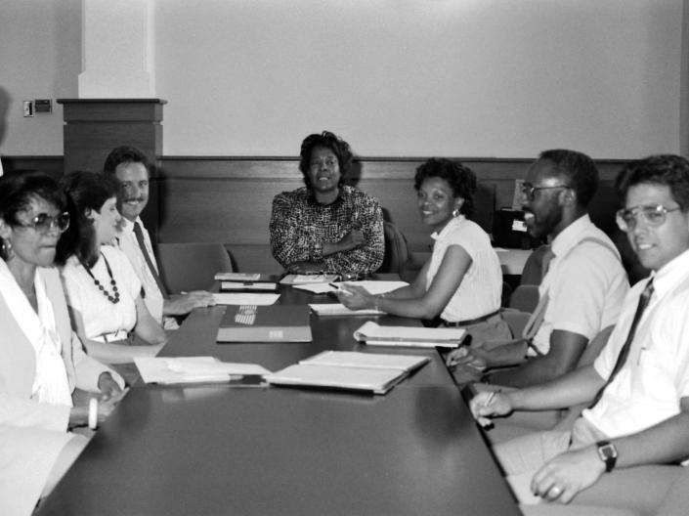
1990-2020
Staff Advisory Council is celebrating its
30th anniversary this year!

Slide 4
The Community Service Committee has had a long history of giving back. When the Council first formed, there were
Cook Books
Bake Sales
Preparing and serving meals at Ronald McDonald House
Holiday Caroling at Judson Manor
Sorting and packing food at the Cleveland Food Bank
Clothing drive for Dress for Success,
Lending a hand at the City Mission
…..and so much more over the last 30 years.

Slide 5
Terri Gieger and Christy Kehoe (wearing the hats in the next picture)
were among the first Co–Chairs.
When doing our 20-year anniversary video, Terri and Christy remember starting the Basket Raffle and also going to the President to suggest a Community Service Day.
Christy had this to say, “I think I am most proud of our suggestion for a Community Service Day. I remember taking our proposal to the president and how it felt like going to see the Wizard of Oz.”

Slide 6
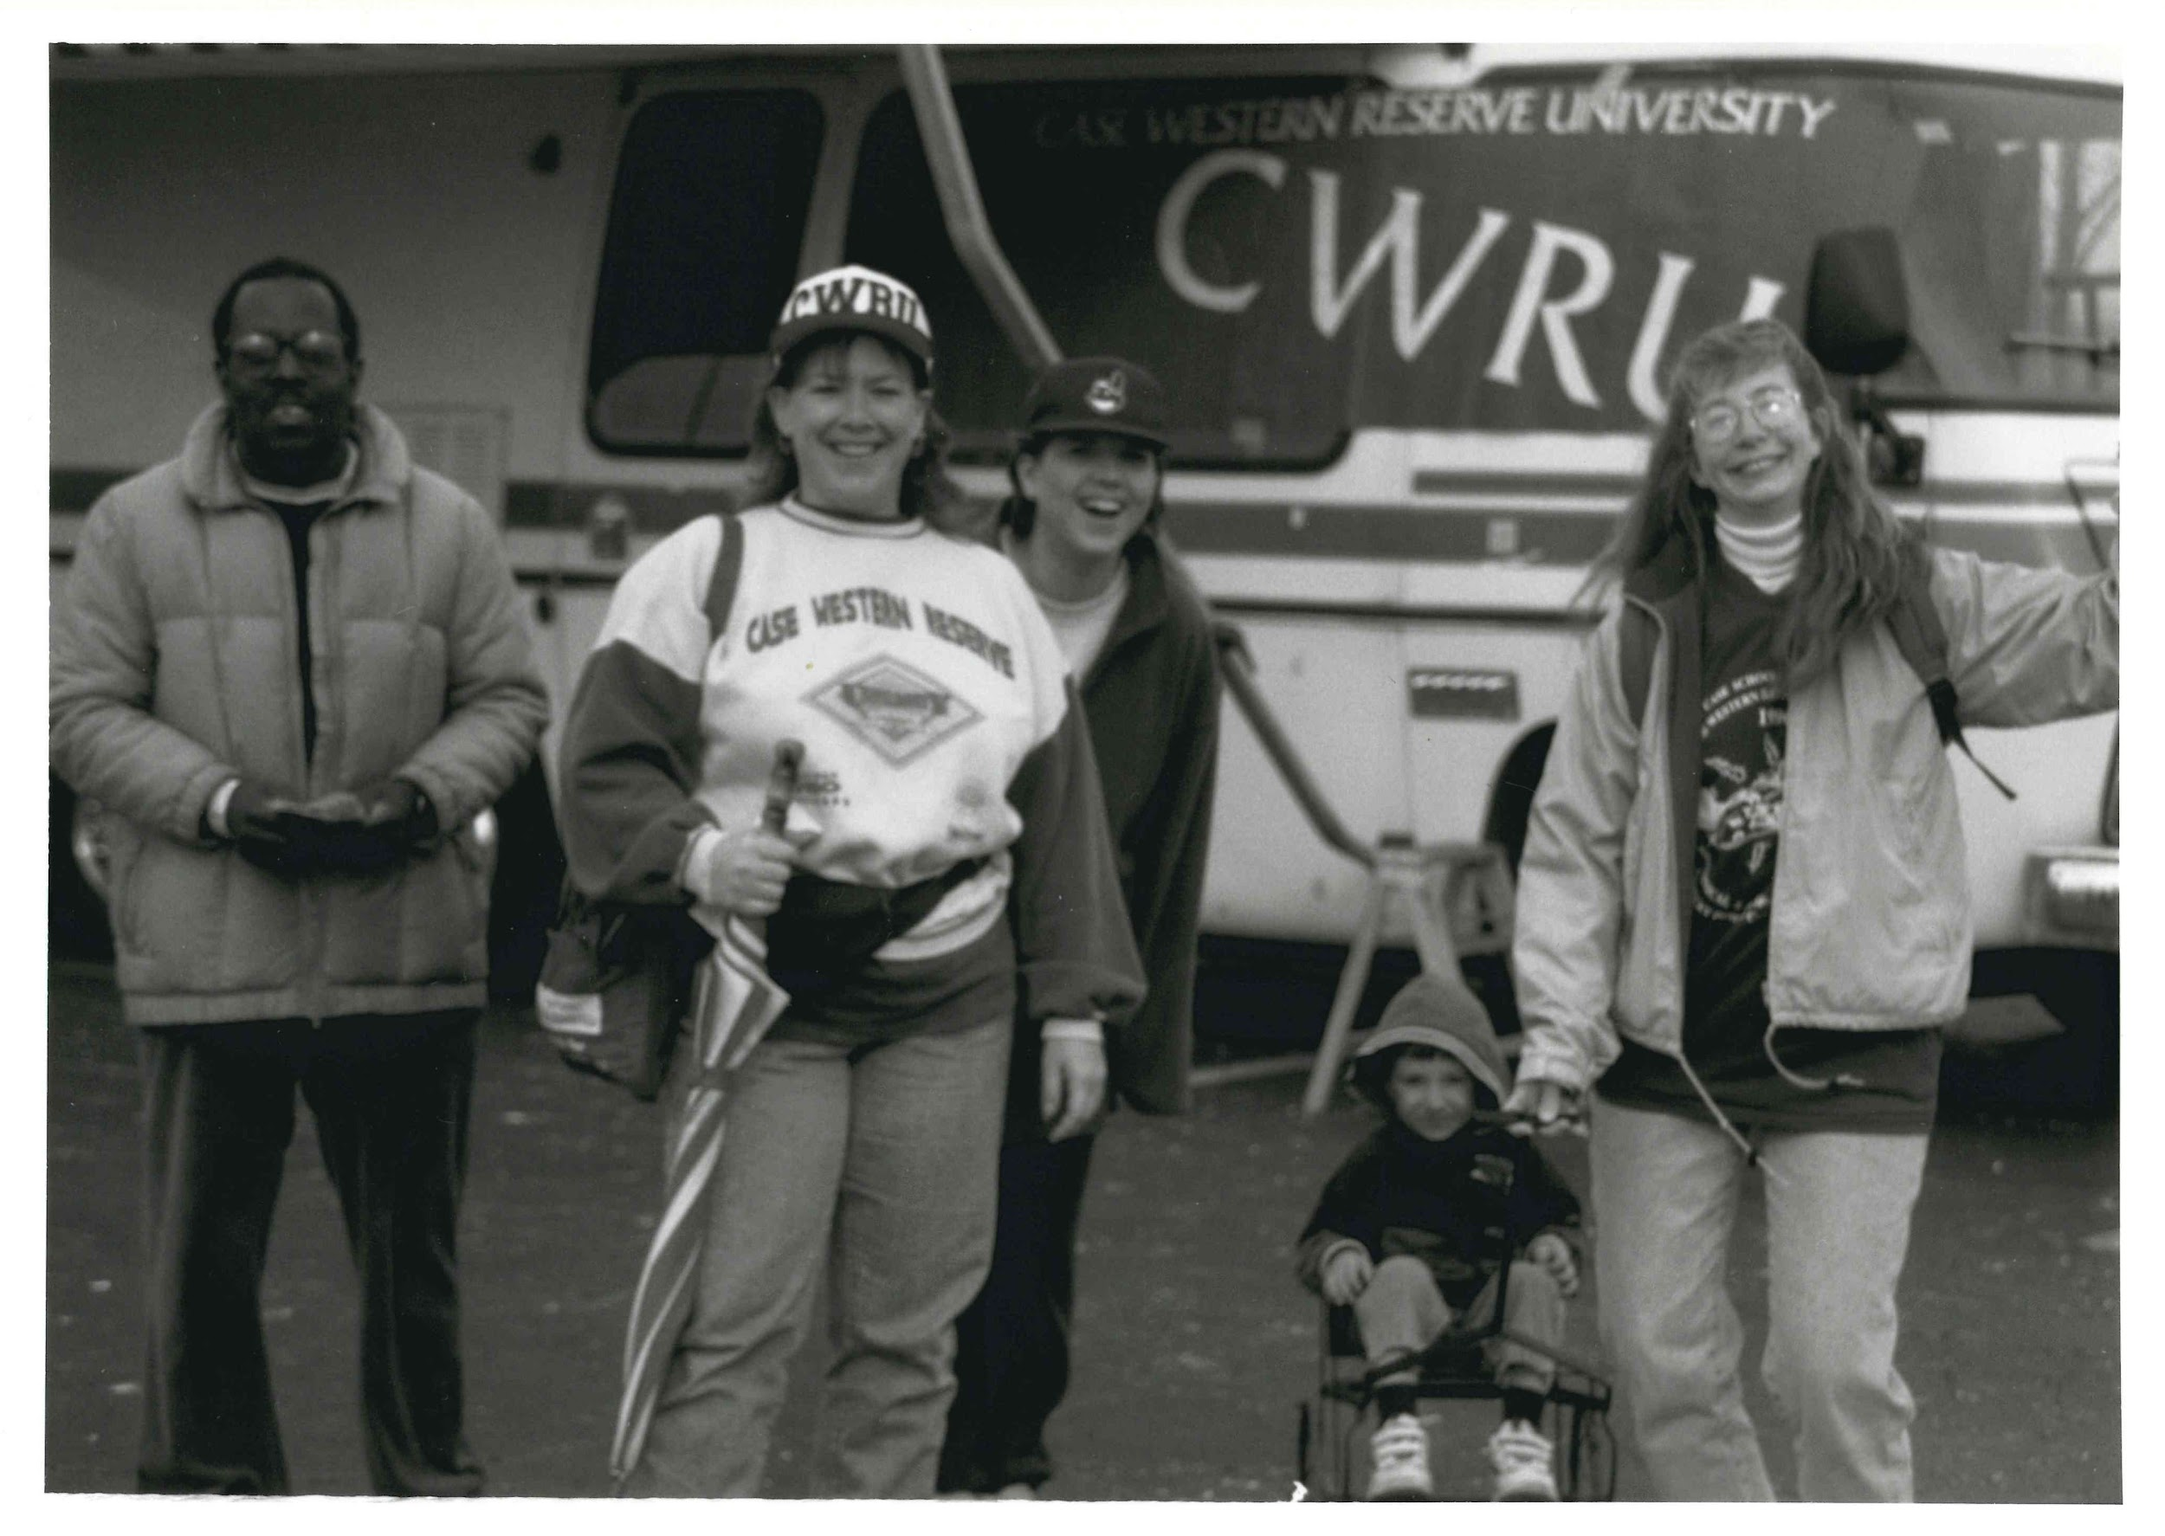
March of Dimes Walk

Slide 7
We had to cancel the traditional Basket Raffle this year.

Slide 8
We still want to celebrate!
Please enjoy a look back at 30 years of the
SAC Community Service Committee

Slide 9
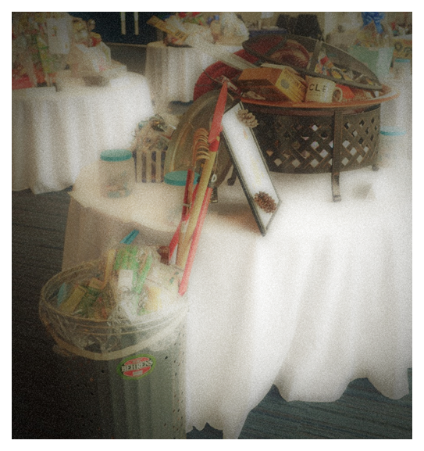
20 years of Basket Raffles

Slide 10
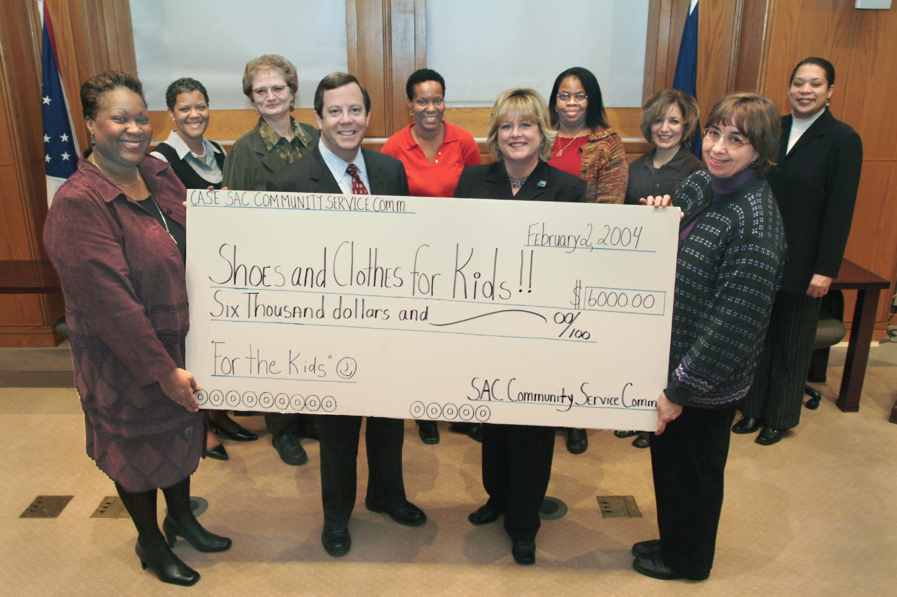
2001 Providence House
$1600
2002 Joseph Landis
&
Mary Bethune Elementary Schools
$5000
2003 Shoe and Clothes for Kids
$6000
2004 Shoes and Clothes for Kids
$4500
2005 Salvation Army, Hurricane Katrina
$6000

Slide 11
2006 Cleveland Hunger Network
$5,500
2007 Restore Cleveland Hope
Cozad Bates House
$4000
2008 Transitional Housing
$4000
2009 MetroHealth
Friends of Mothers & Infants
$1000
Bellflower Center for the Prevention of Child Abuse
$3000

Slide 12
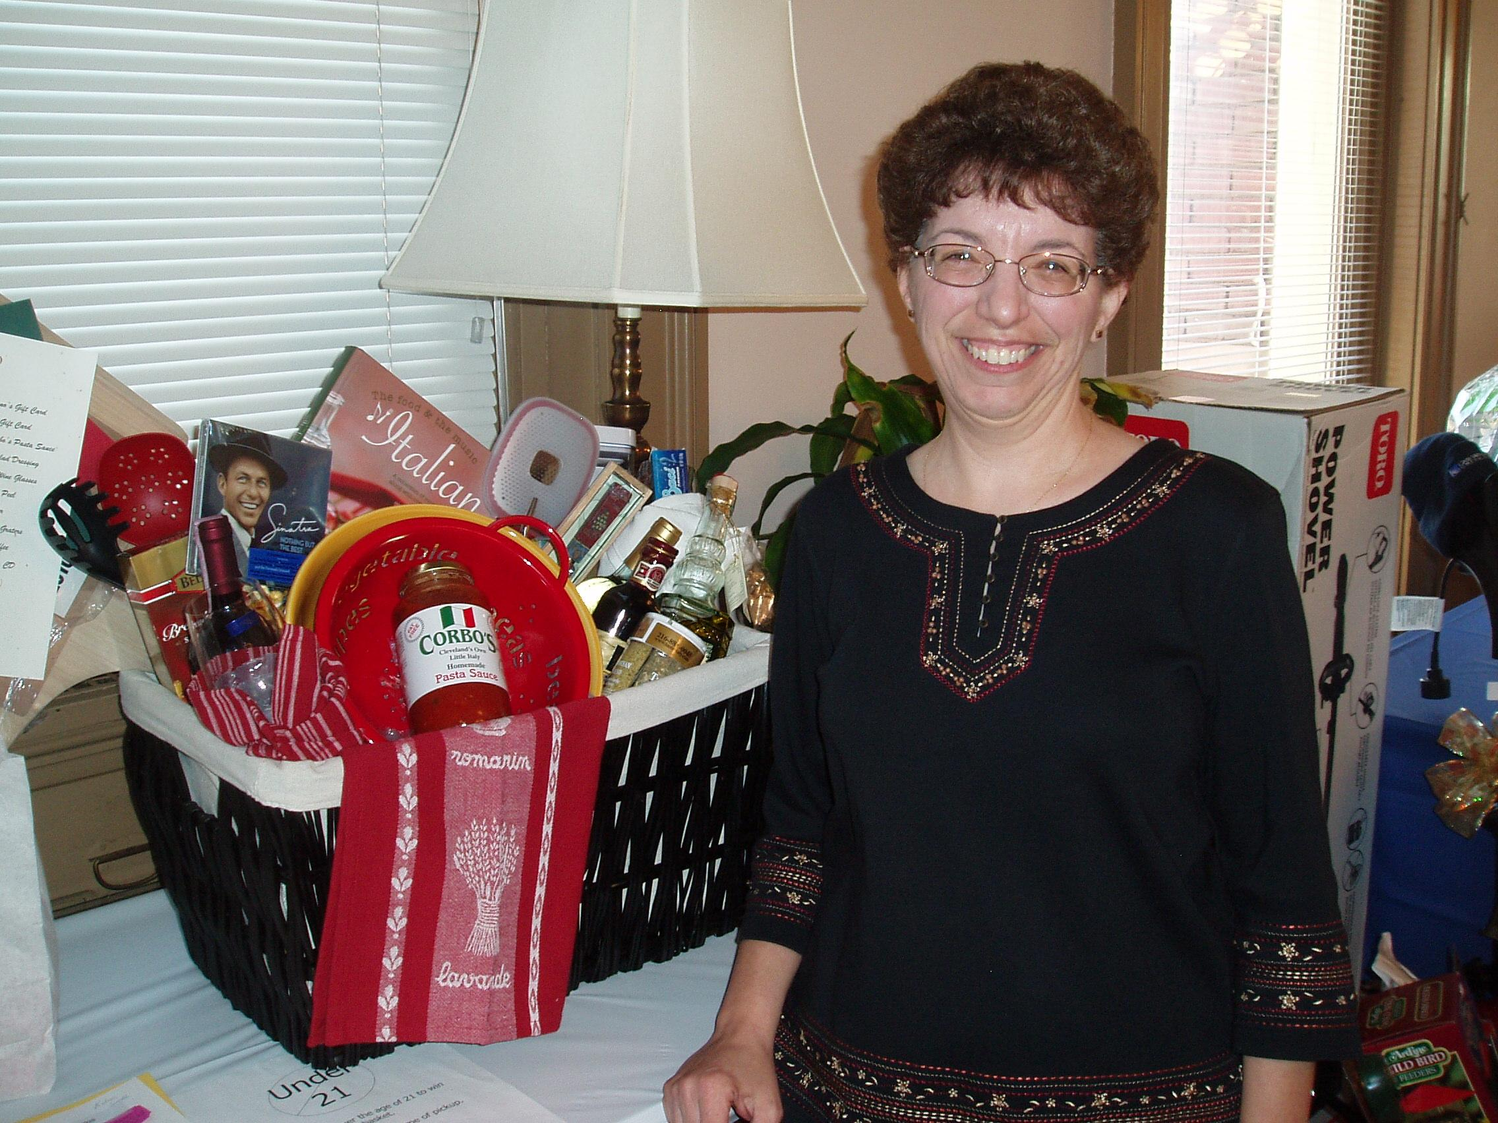
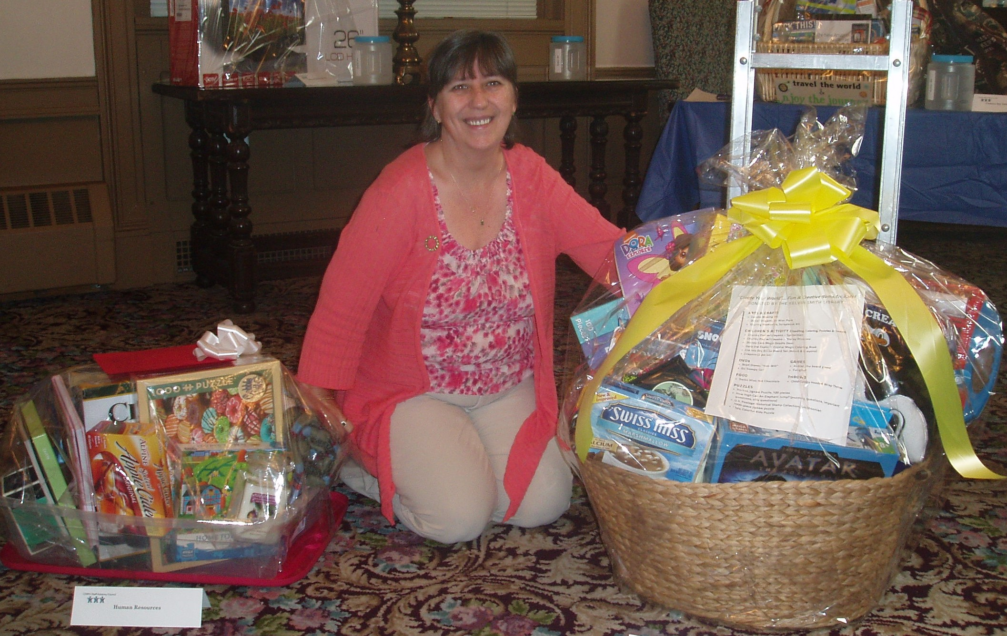
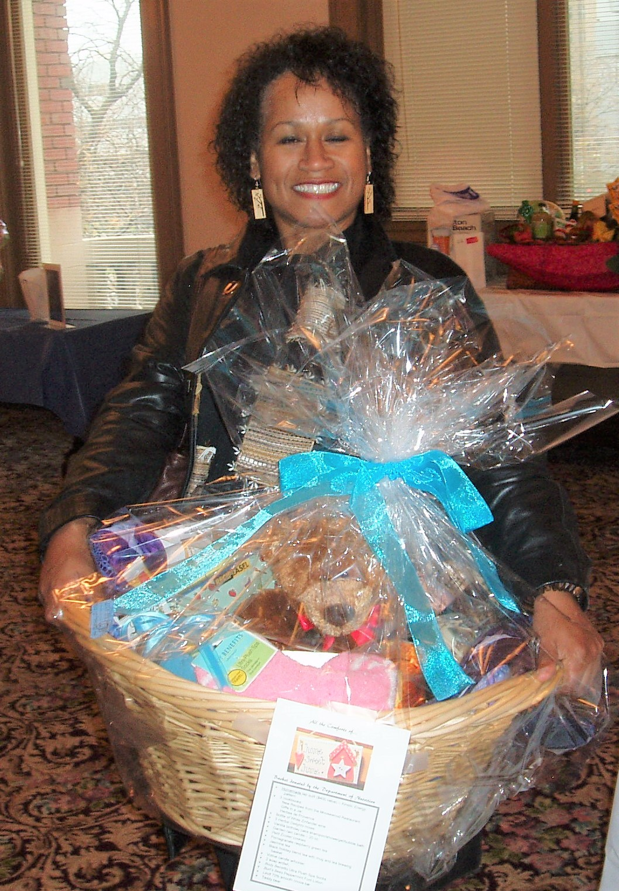
2010 Suicide Prevention Education Alliance
$4,500
2011 Hospice of the Western Reserve
$4,200
2012 Murtis Taylor Human Services System
$4000
Youth Challenge
$1,500

Slide 13
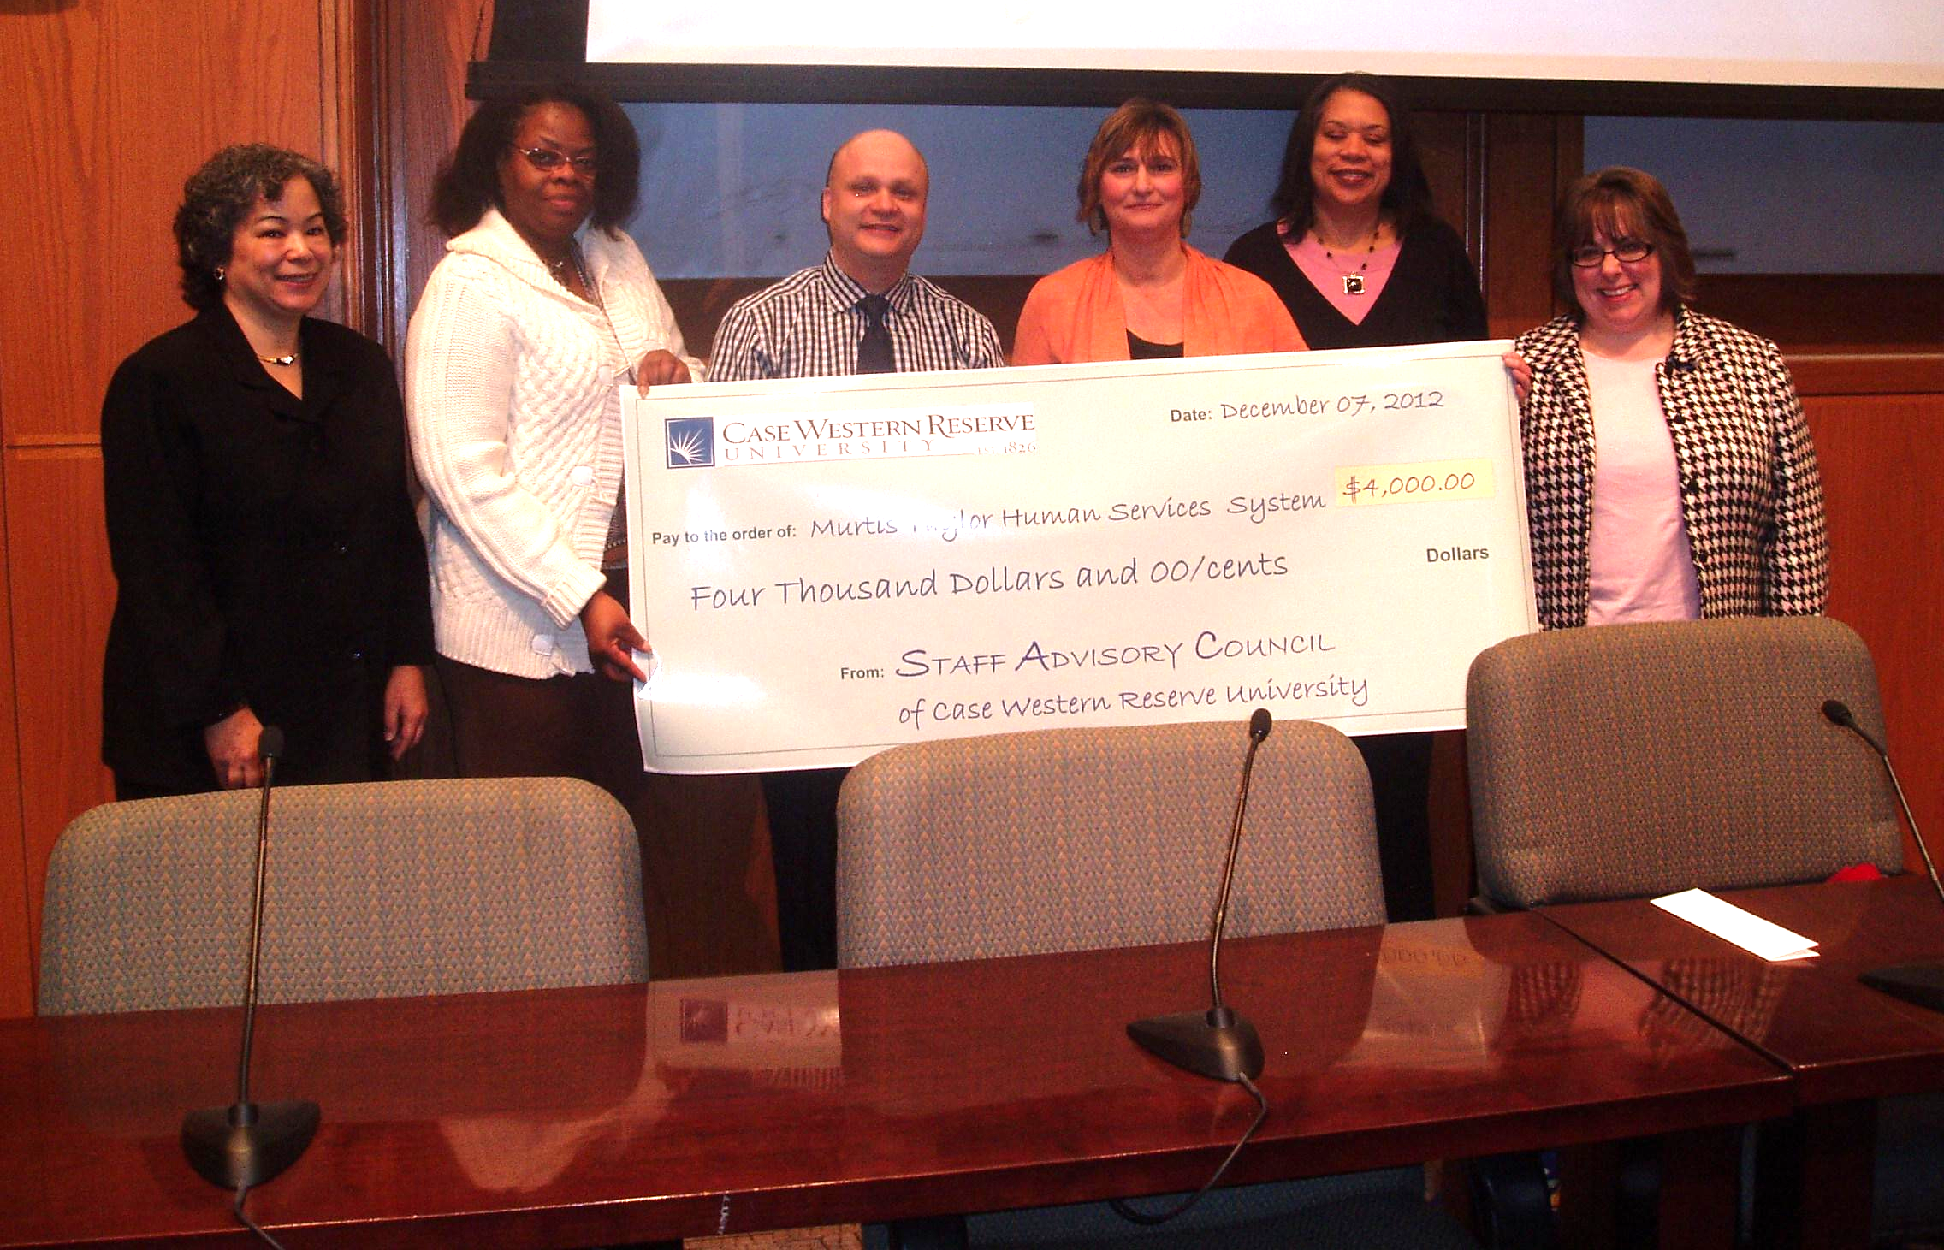
2012 Basket Raffle check presentation

Slide 14
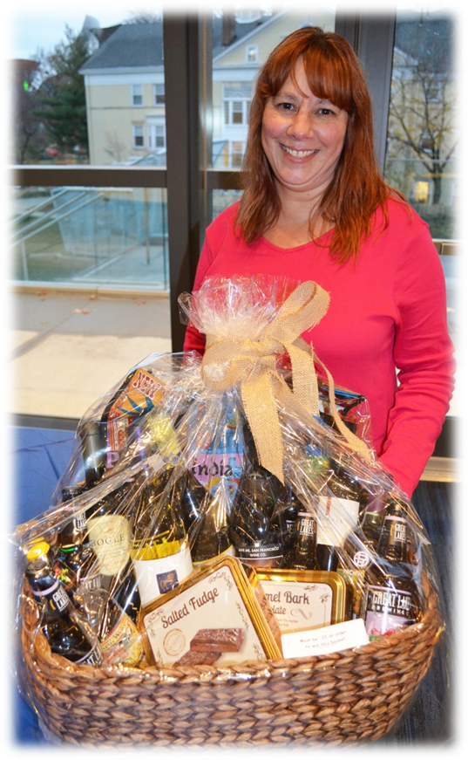
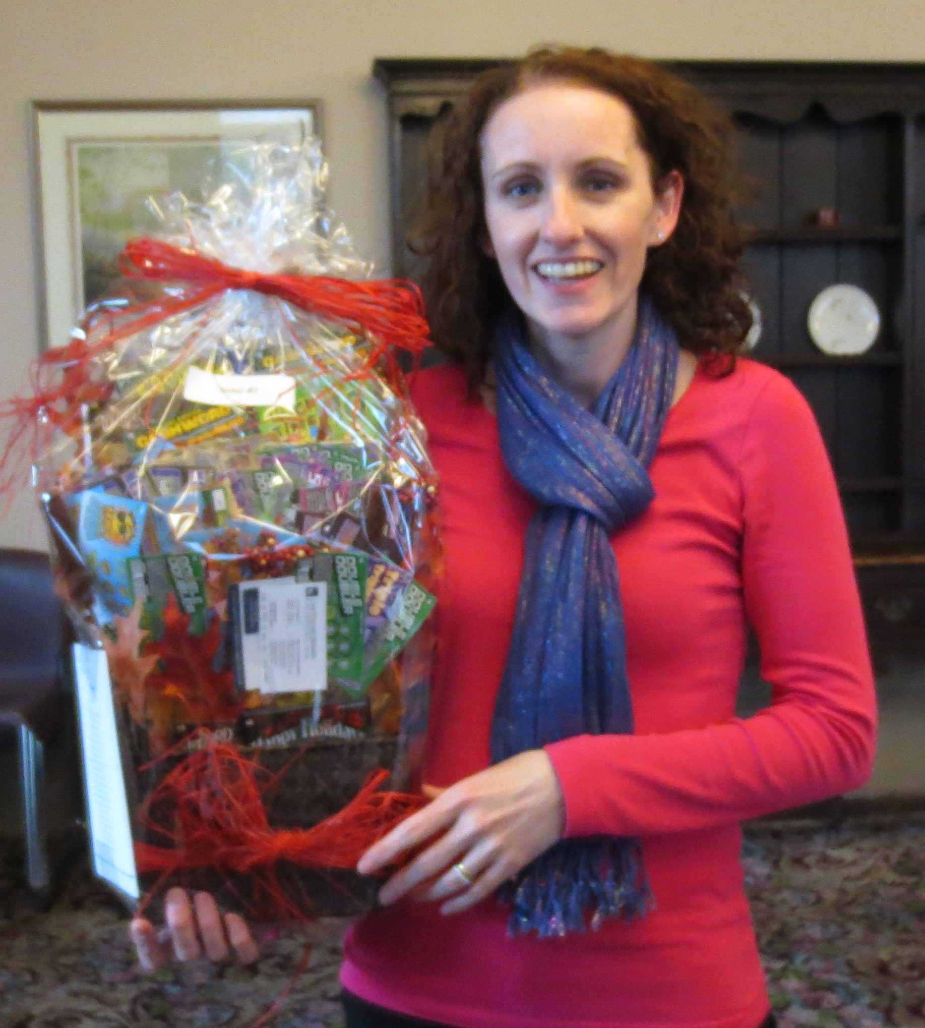
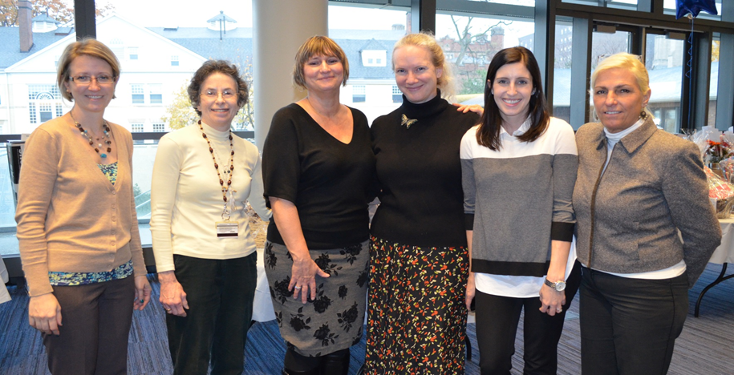
2013 Project Night Light & Family Promise
$4000
2014 Seeds of Literacy
$4000
2015 US Together
$5000

Slide 15
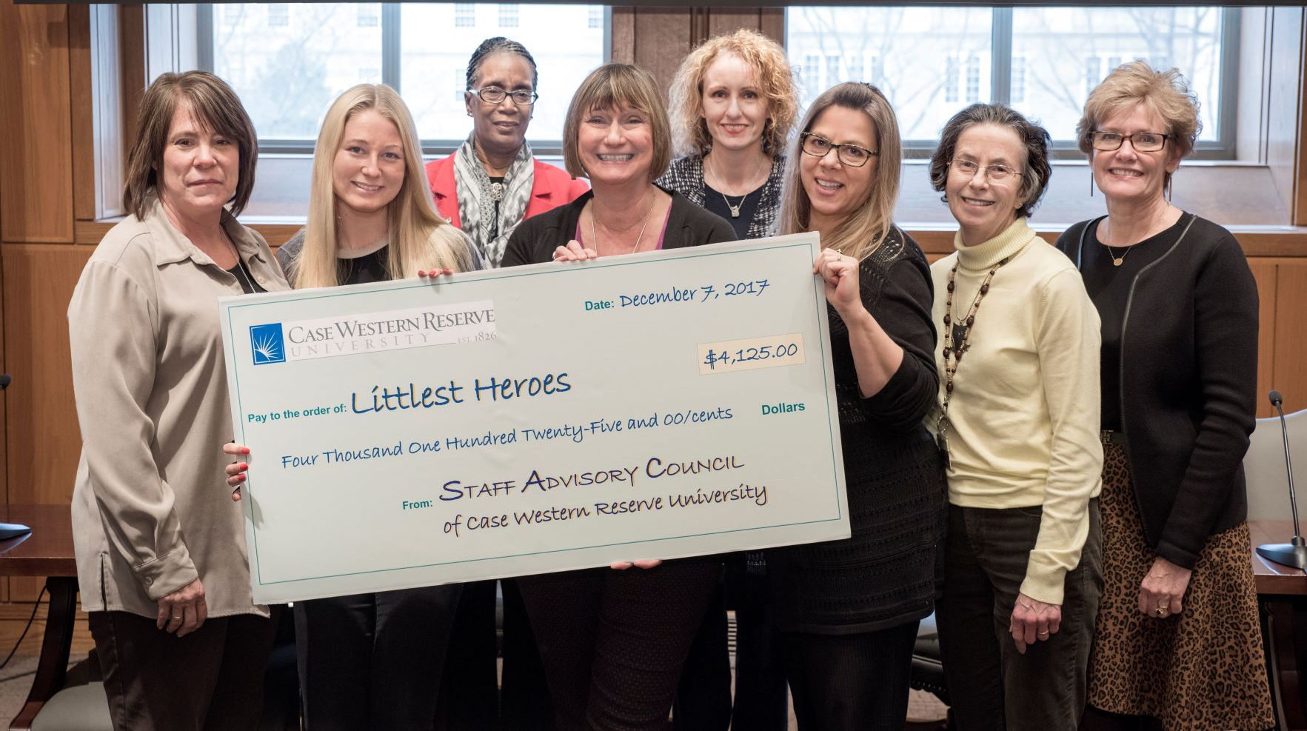
2017 Community Service Committee
Basket Raffle check presentation to the Littlest Heroes

Slide 16
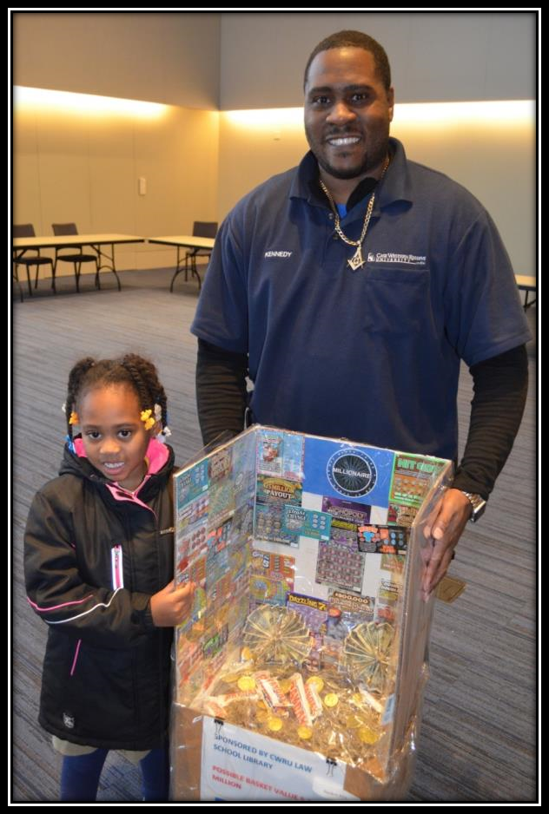
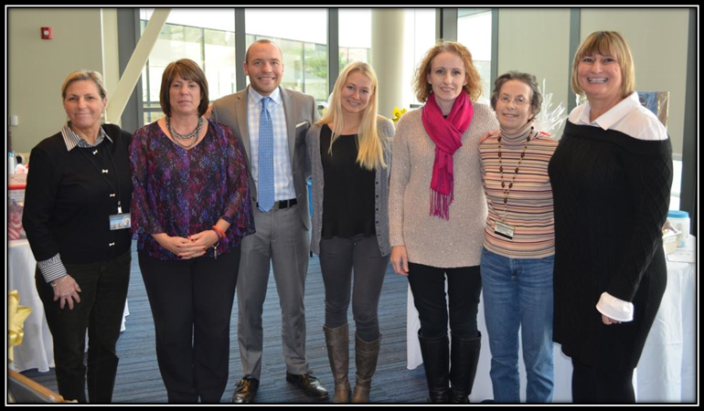
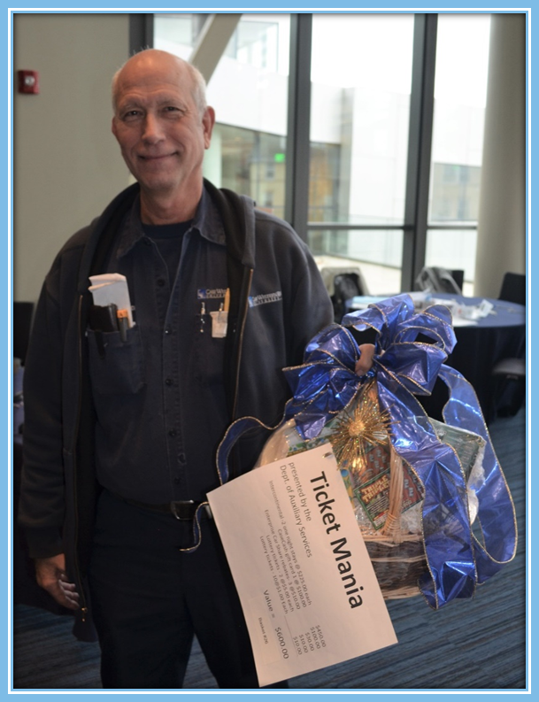
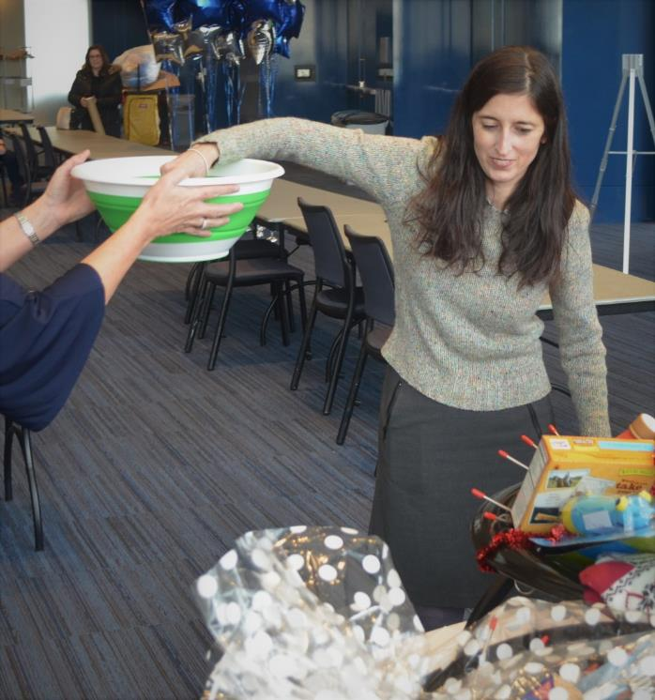
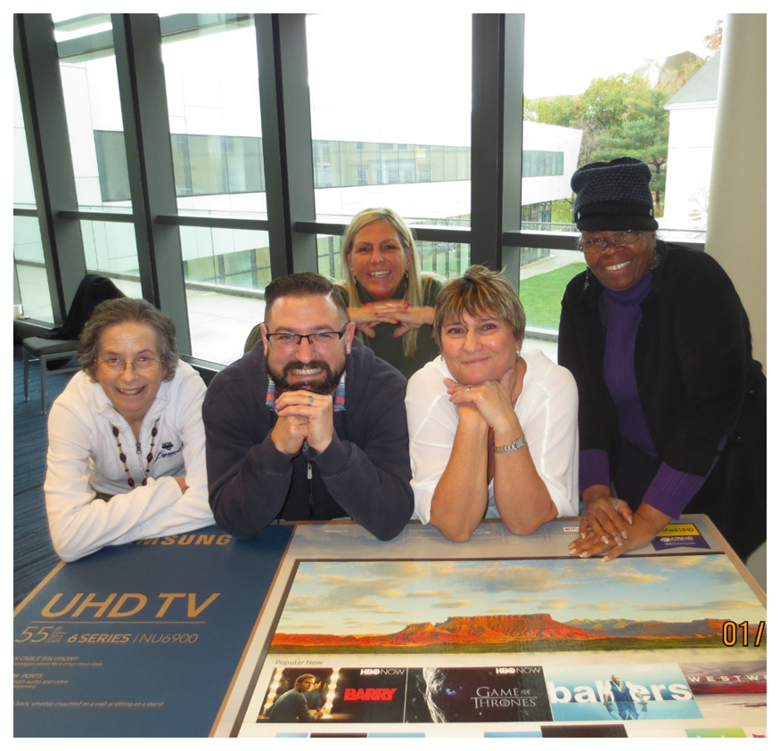
2016 HandsOn Northeast Ohio
$3,600
Shelli Snyder Medical Recovery Trust
$1,000
2017 Littlest Hero's
$4,125
C.E. Middle School , Houston Texas
$2,125
2018 Rainbow Connection Animal Foundation
$5,400
2019 West Side
Catholic Center
$5000

Slide 17
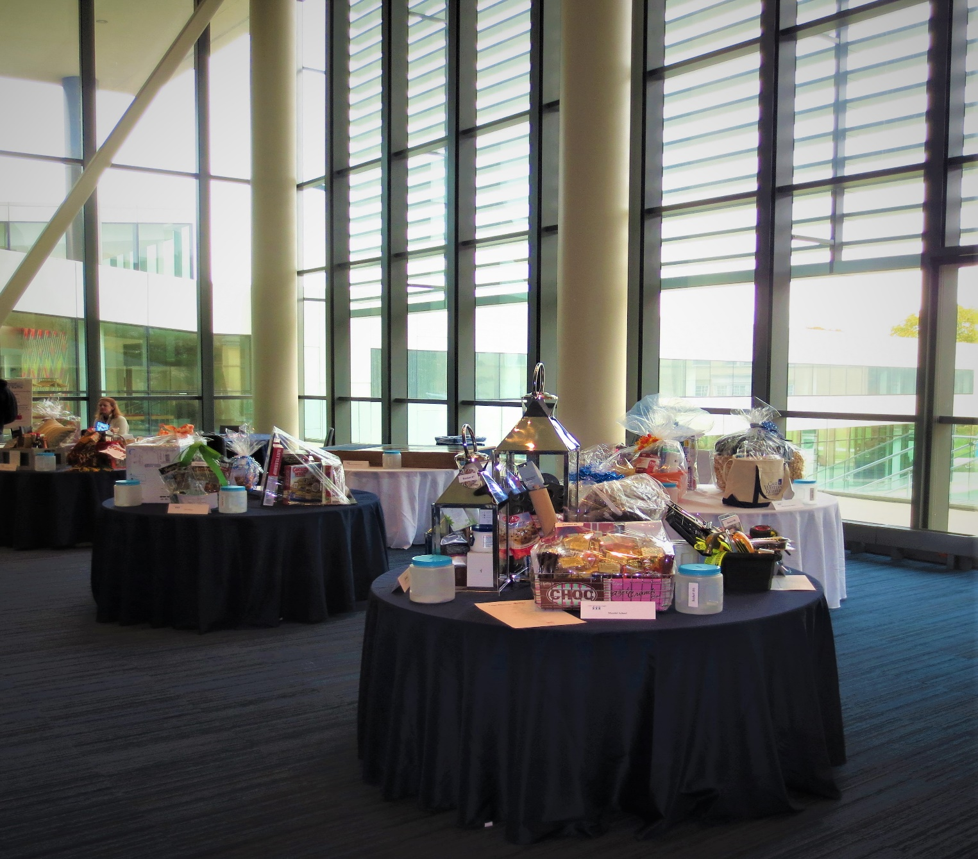
Over the past 19 years, we have raised a grand total of $92,550.00

Slide 18
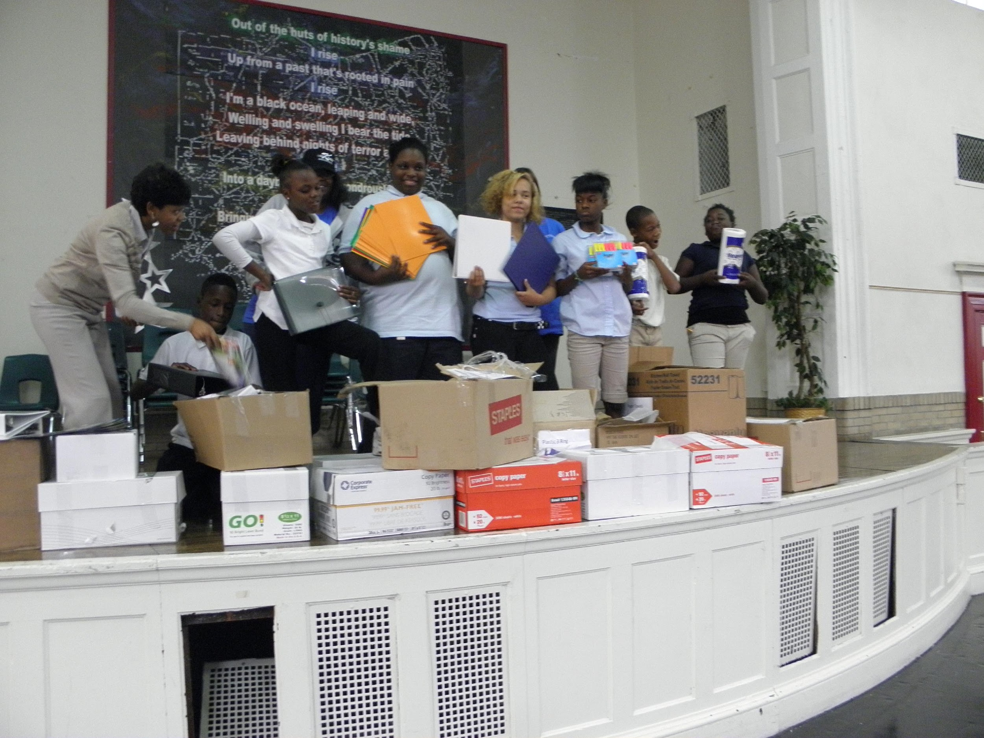
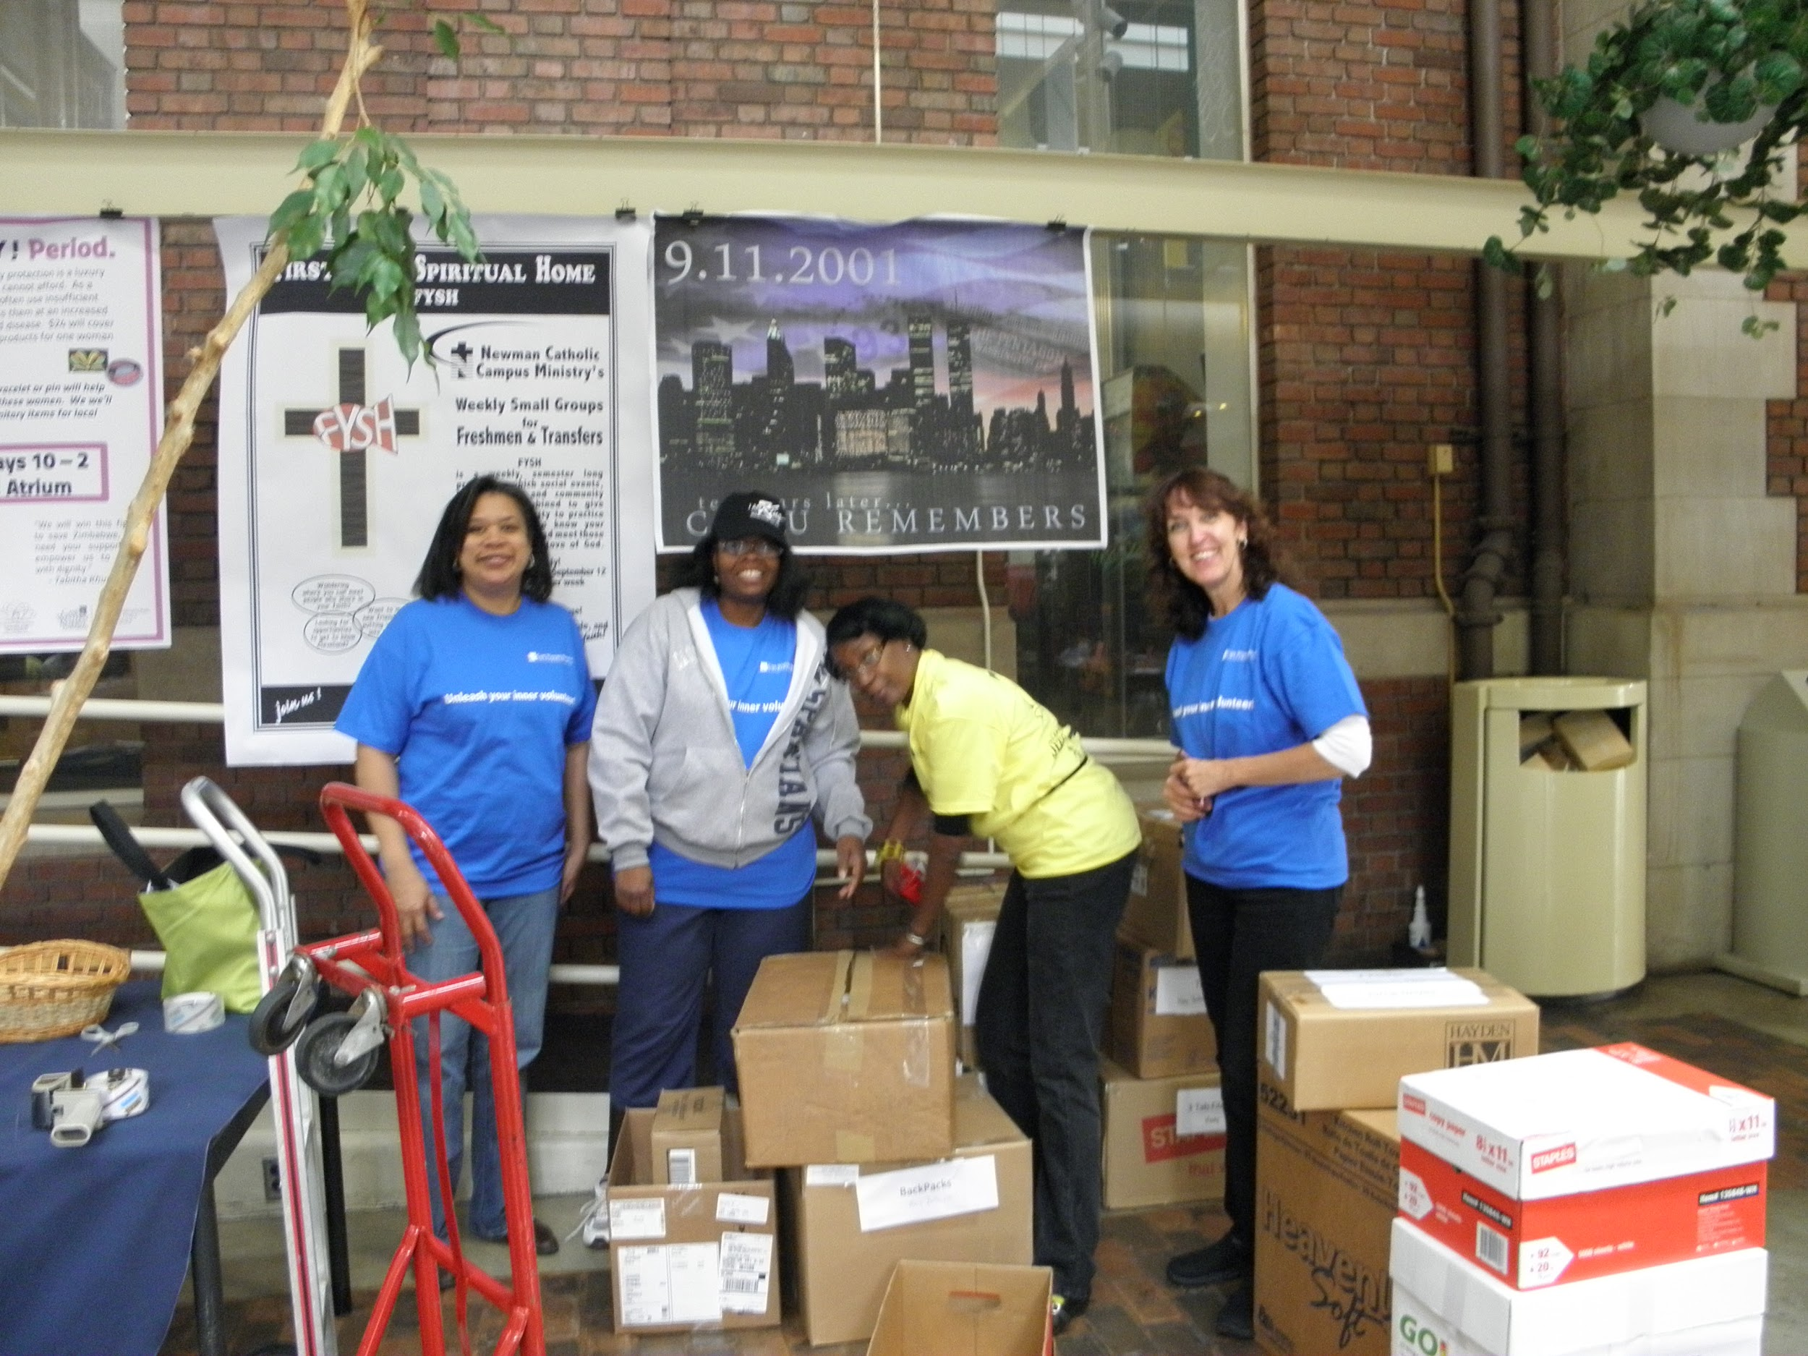
In 2011, we started a new tradition

Slide 19
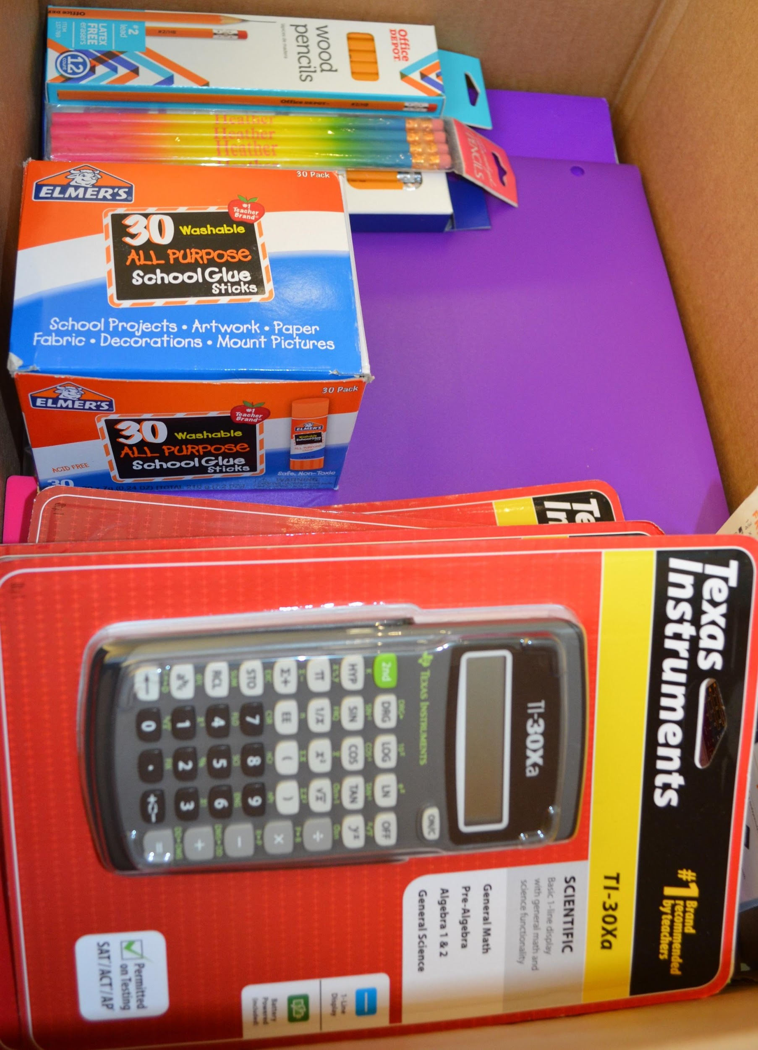
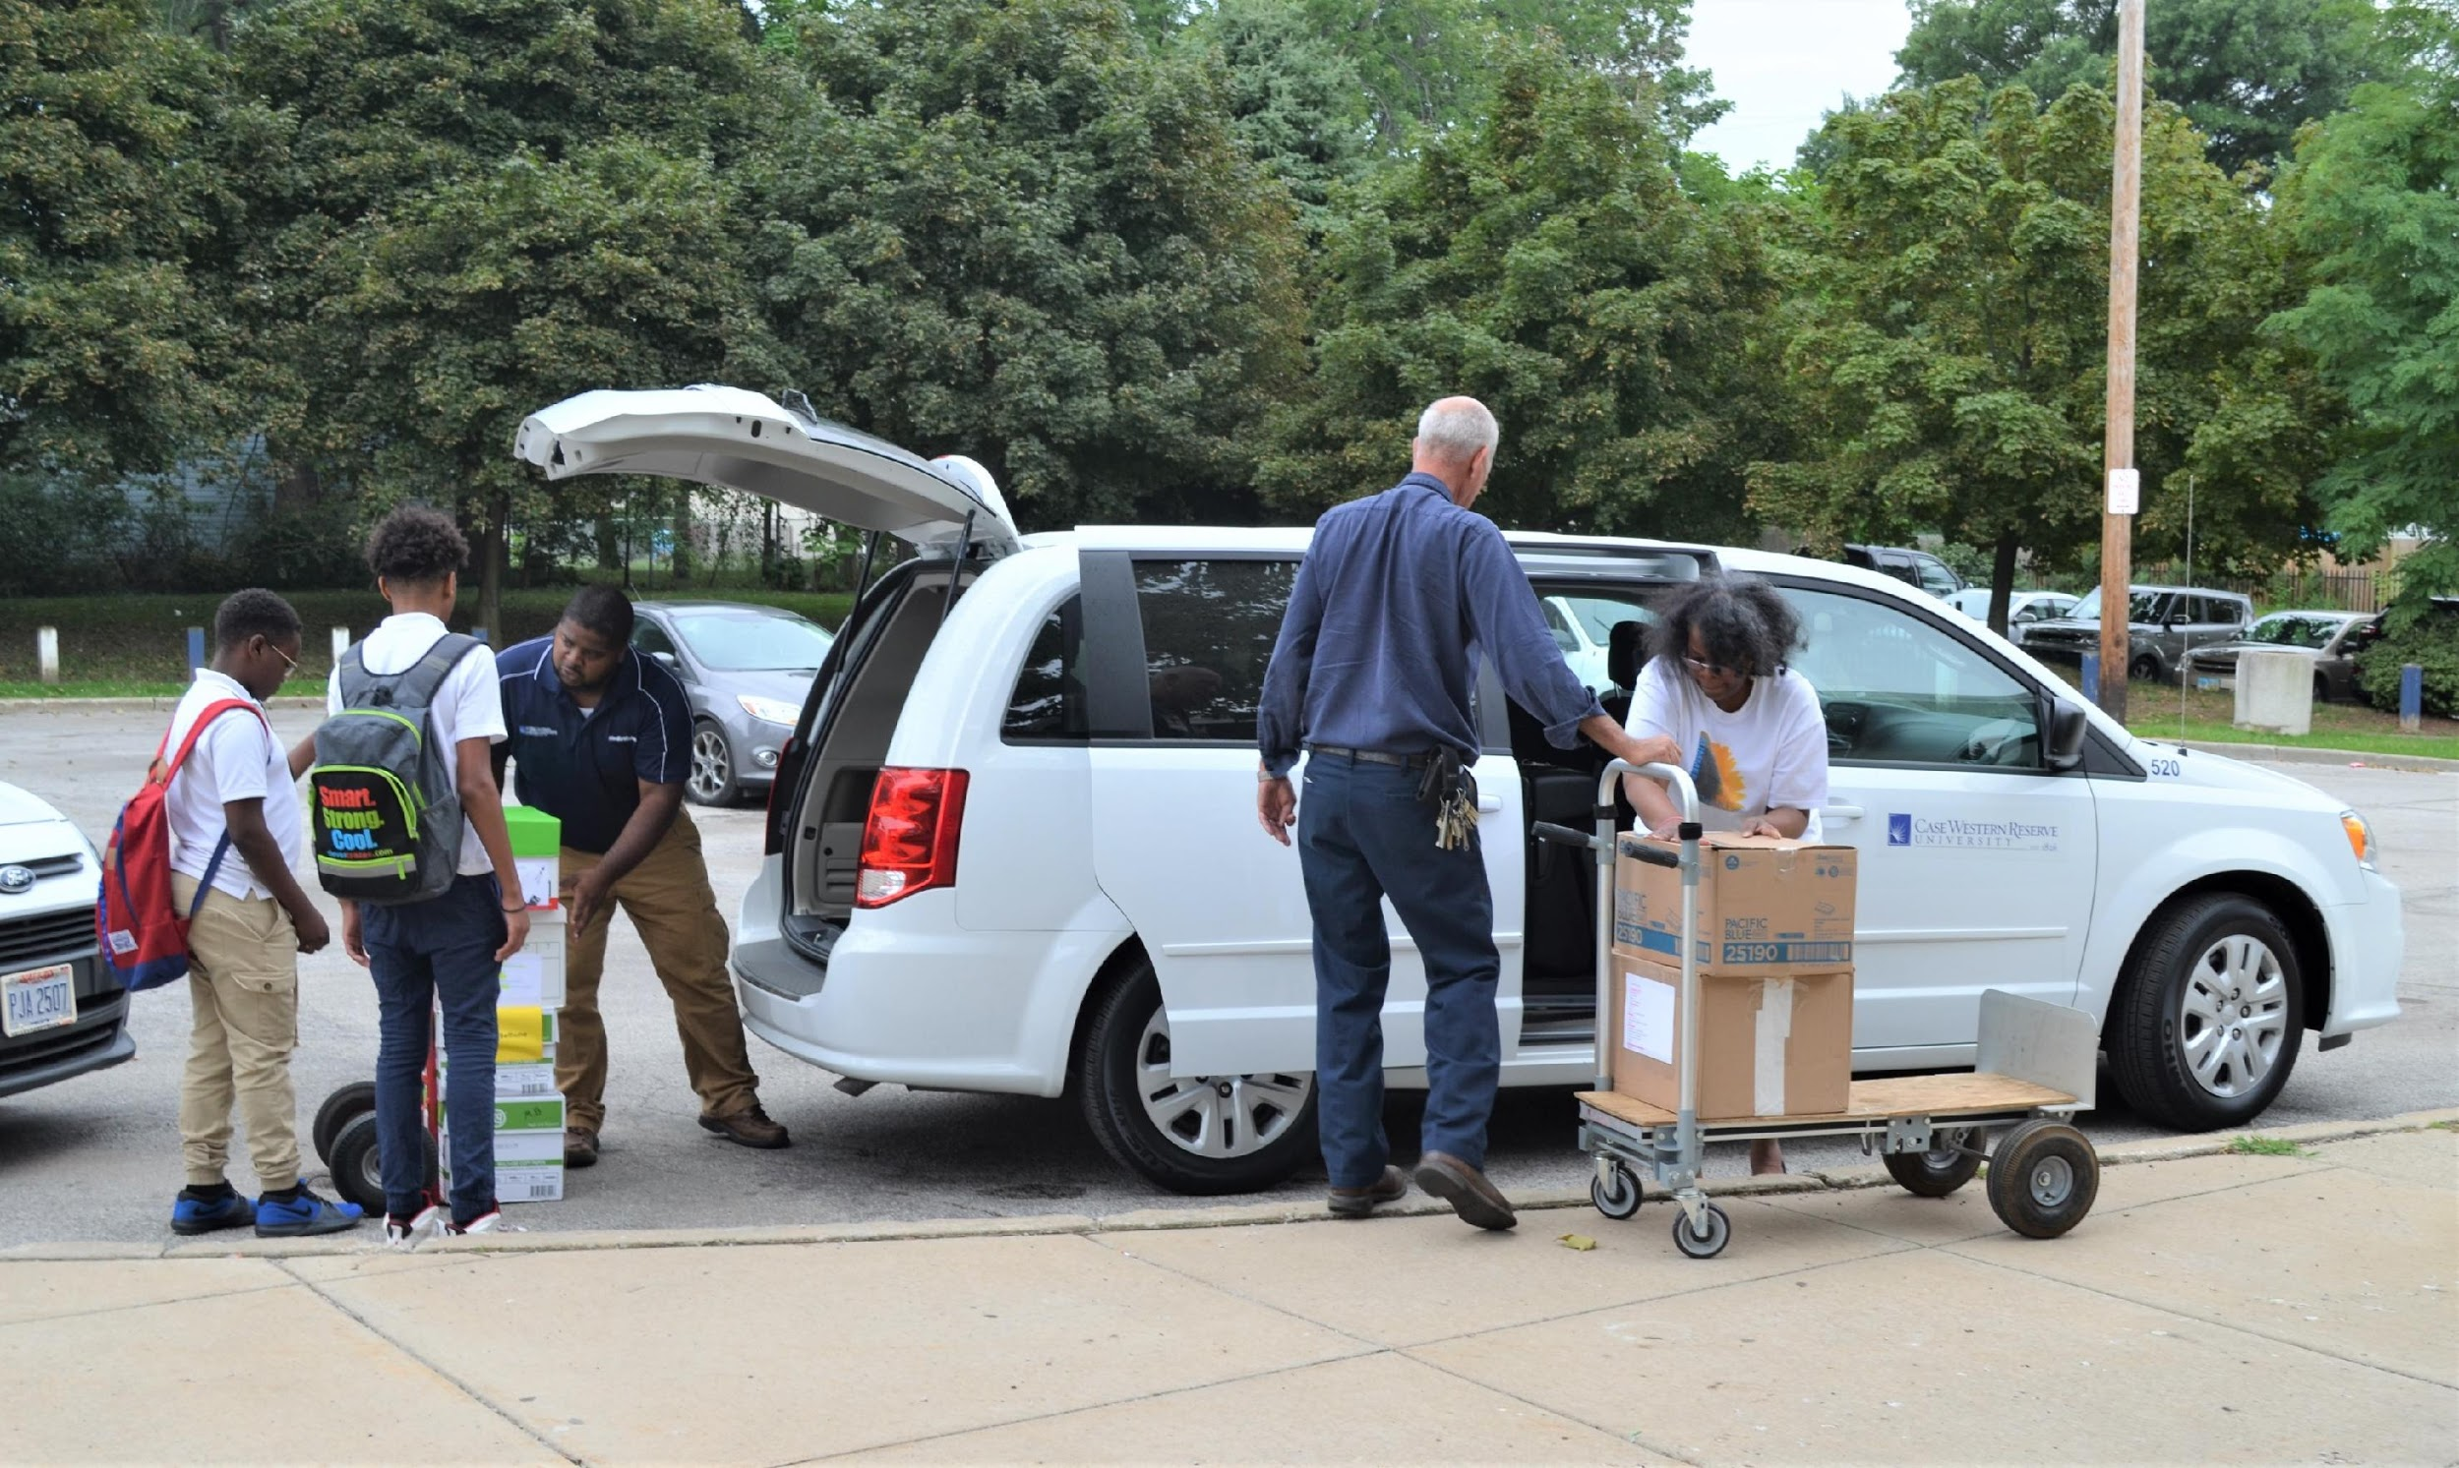
We collected School Supplies for some local schools.
We started with Michael R. White and Mary Bethune.
A few years later, we added Daniel Morgan,
and last year we added Anton Grdina.

Slide 20
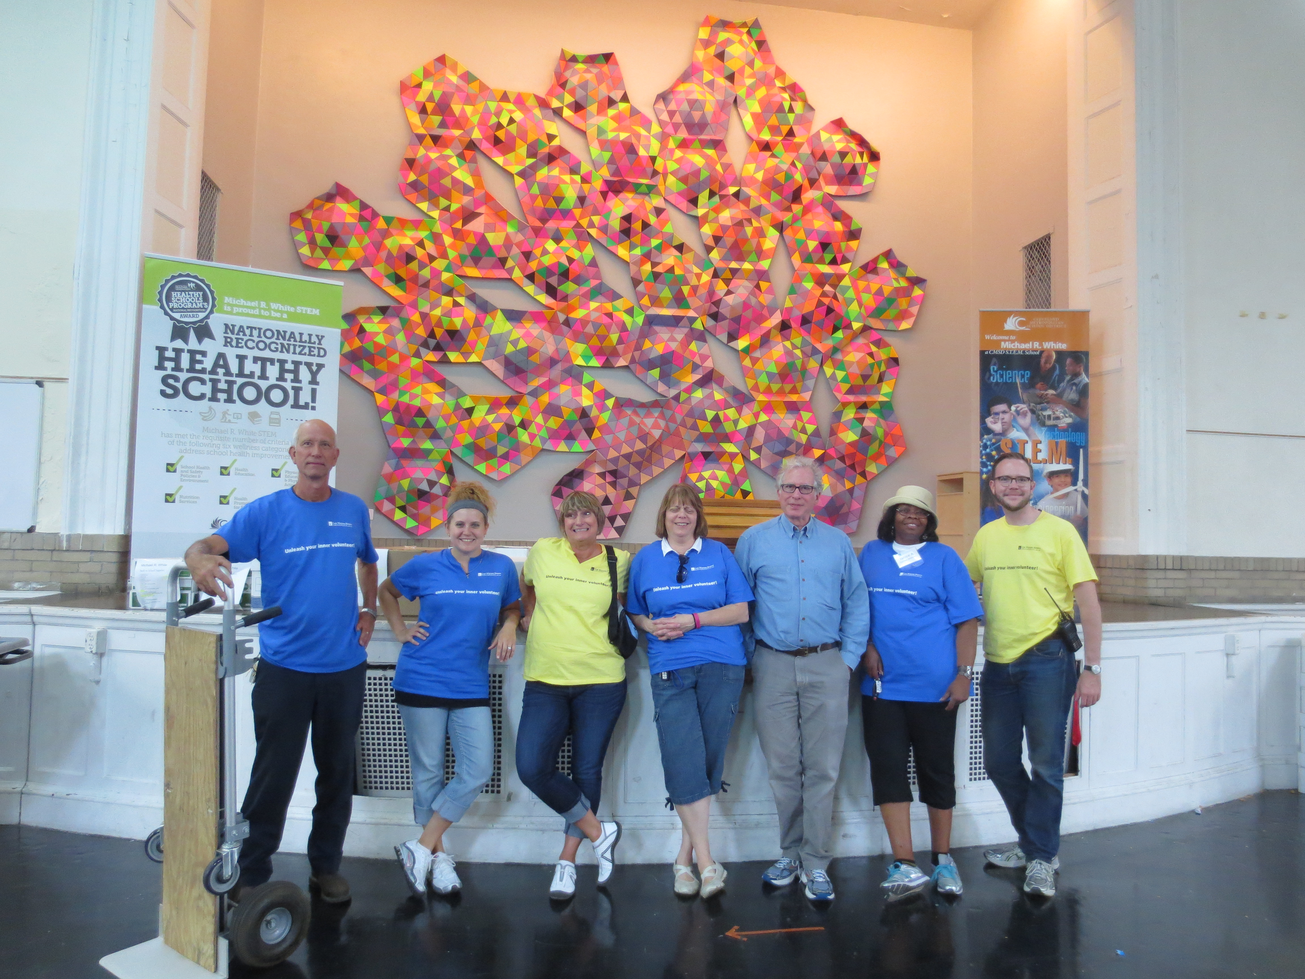
Back to School Supply Drive 2015

Slide 21
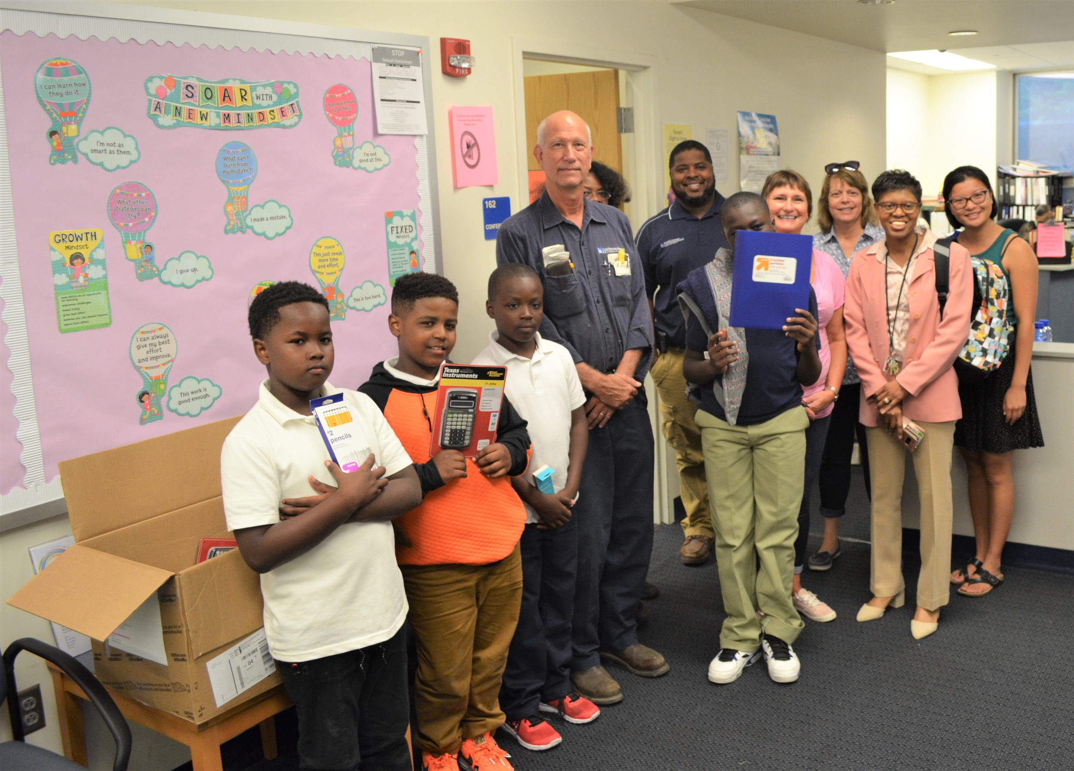
Back to School Supply Drive 2018
AND here are our lucky winners……..
Congratulations to ALL!!!

Slide 22
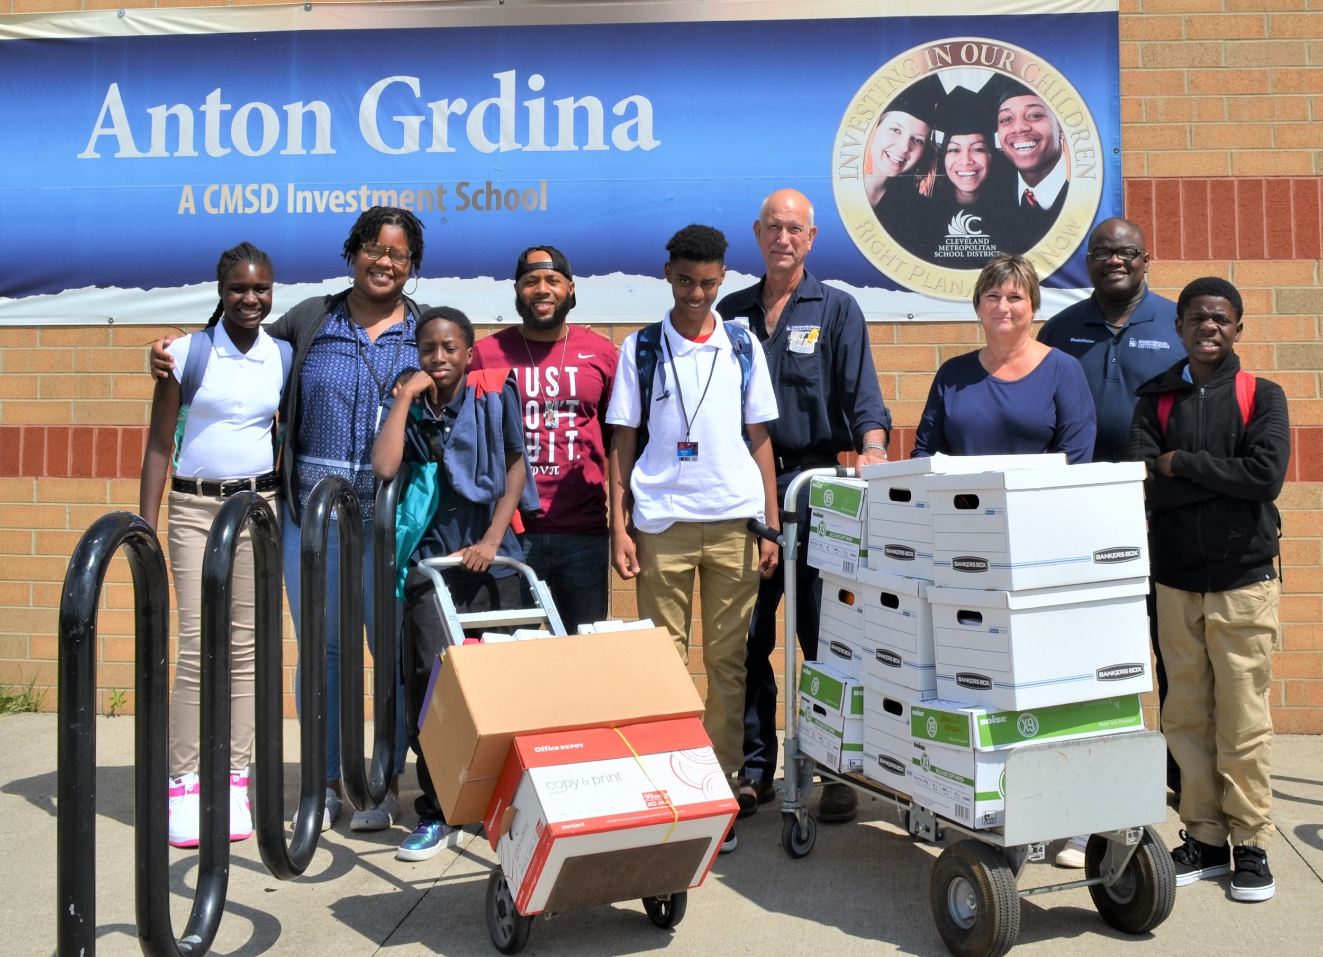
2019
Back
to
School
Supply
Drive

Slide 23
August 18, 2014
The Community Services Committee proposes to add a new component to its mission by partnering with Crafters@Case.
In 2013, Crafters@Case was formed with a mission to “reach out to support the homeless in Cleveland and let them know that someone cares by creating knitted/crocheted items to help them keep warm during the harsh winter months.” Last fall they created more than 110 hats and scarves which were donated to the SAC/Care Alliance Winter Clothing Drive. This year, in addition to donating items to the City Mission and SAC/Care Alliance, the Crafters have expanded their scope of service by selling items and donating the proceeds to the Cleveland Food Bank, where every dollar donated provides four meals. Experienced crafters are always happy to show the newcomers how to knit or crochet. In addition to the satisfaction of helping others, the members enjoy the camaraderie of a diverse group of staff in a relaxing, stress-reducing and nurturing environment.
Anyone can be a Crafter@Case! If you want to knit, crochet, or have a creative interest to share, please join Crafters@

Slide 24
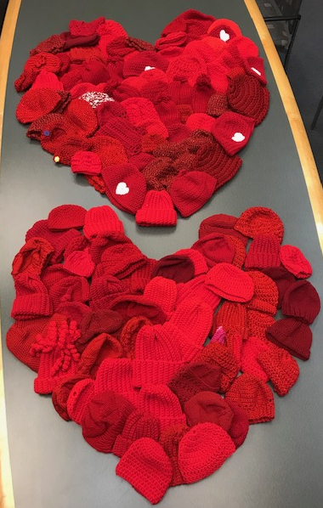
Crafters@Case
2018
209 hats donated to the Little Hats, Big Hearts American Heart Association drive
59 hats donated to RB&C
331 items donated to St. Herman’s & Providence House
Holiday Sale: more than 220 yarn items, ceramic pieces, accessories and holiday décor items
Proceeds from sales and donations $1270 + $500 (Good Neighbor fund) = $1770
Donation made to the Cleveland Food Bank
2019 Little Hats, Big Hearts
145 little red hats made and distributed to the American Heart Association

Slide 25
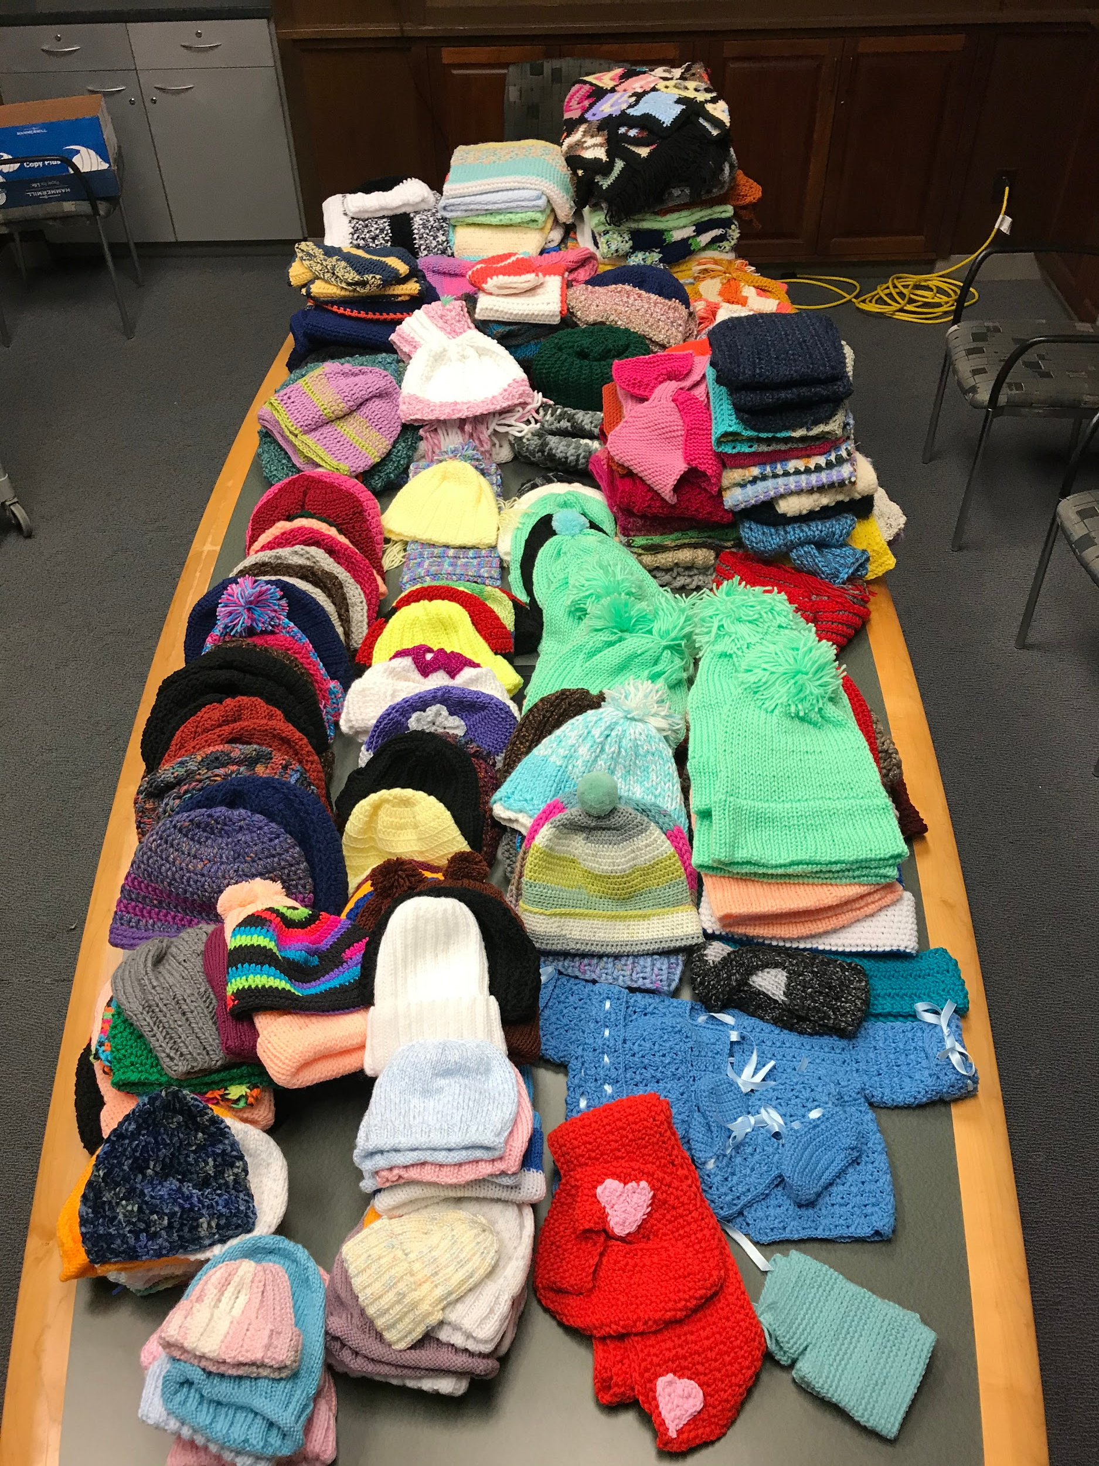
January 2020
Crafters@Case donated 170 hats, scarves, gloves, blankets and other items to the Cuyahoga County Division of Children and Family Services.

Slide 26
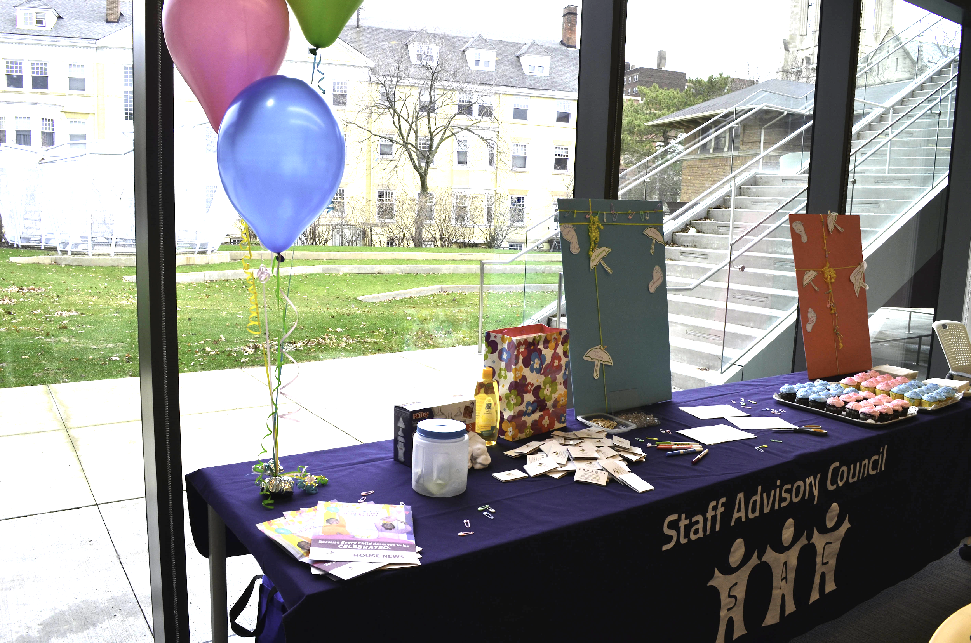
2018
Baby Shower for Providence House

Slide 27
This past September we launched
Volunteerism Version 2020

Slide 28
We asked that the CASE community take up volunteering on their own
We had several participants doing all kinds of projects.

Slide 29
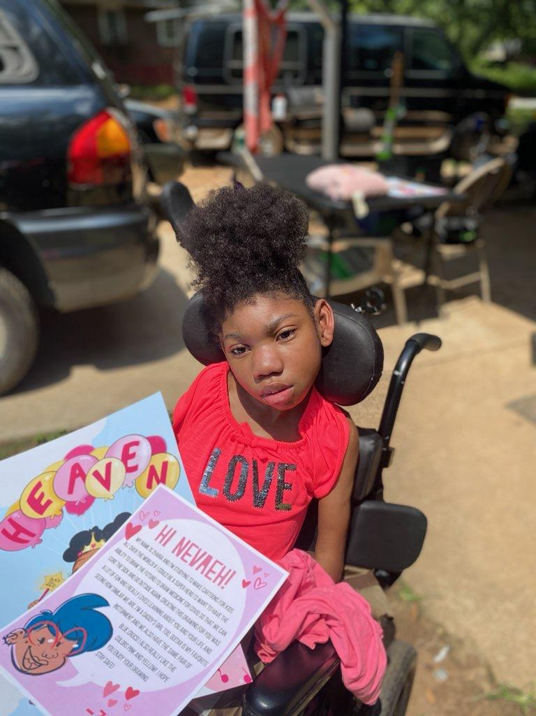
Tamer Nagy
Did beach clean up
Adolfo Franco
May Dugan Community Center Bimonthly Food Distribution
Kate Klonowski
Helped a young mother in need
Pam Strathman, Melanie Prestage, David Retzer and Fatima Abidi donated school supplies
Robin Brown
Cleaned out the closet for clothing donation
Lisa Kollins
Interviewed youth with serious illnesses and special needs about how their superhero alter egos will make the world a better place,. Superhero Project - www.superheroprojectkids.org.

Slide 30
Thank you to all who participated over these many years by donating a basket, making a donation, purchasing tickets, donating school supplies and/or volunteering.

Slide 31
CWRU has a history of giving and caring
There may not be basket winners but let's make everyone a winner by doing some
Community Service
Please consider giving back, if you look back through these slides there are so many opportunities to make a difference today

