Slide 1
Faculty Council April 17, 2023
Program Review Committee

Slide 2
Program Review Committee Charge
Standing committee of the Faculty of Medicine.
Serves as the “college curriculum committee” in the CWRU approval matrix.
Reviews major changes to existing programs (>50%)
Presents recommendations to the Faculty Council
Review other non-MD programs at the Dean’s request.
Distinct from the Curriculum Review Committee that reviews new courses.

Slide 3
Committee Members 2022-2023
5 Faculty Leading Education Programs 3 Faculty Involved in Education
Nicholas Ziats, Pathology, Chair William Merrick, Biochemistry (2023)
Mendel Singer, PQHS (2023) Nicole Deming, Bioethics (2023)
James Spilsbury, PQHS Hua Lou, Genetics & Genome Sci
Mendel Singer, PQHS (2023)
Aaron Goldenberg, Bioethics
Ex Officio
Hope Barkoukis, Nutrition (2025), Faculty Senate Committee on Graduate Studies
Vivian Yee, Biochemistry (2025), Faculty Senate Committee on Undergraduate Studies
Marvin Nieman, Pharmacology, Vice Dean for Graduate Education

Slide 4
Process
The workflow follows the new online Program Action Form
https://case.edu/registrar/
Faculty and Staff - Curriculum and Program Management
Office of the Provost
https://case.edu/provost/faculty-academics/approvals-and-governance-academic-programs-and-processes
School of Graduate Studies
https://case.edu/gradstudies/faculty/faculty-guidelines/new-program-development-guidelines

Slide 5
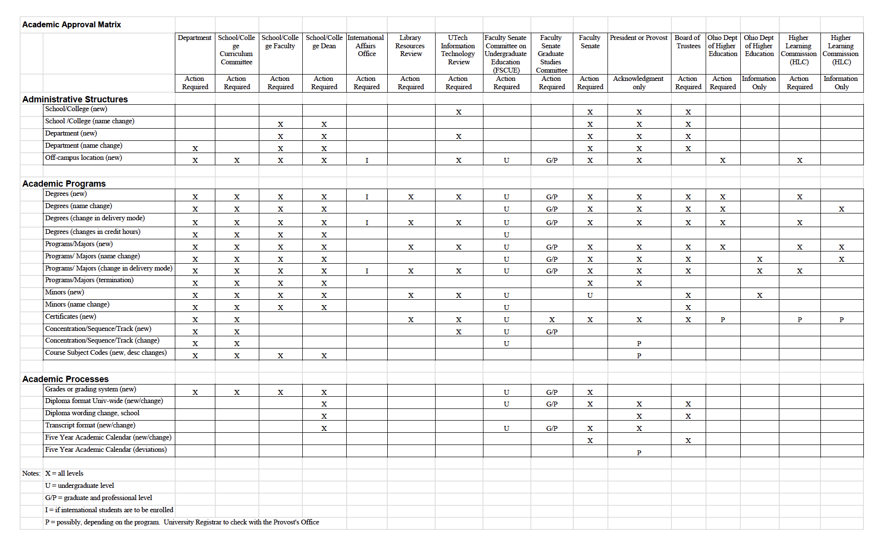
Approval Matrix

Slide 6
Approval Process for New Programs
Department Review
Library Resources Review
UTech - IT review
Program Committee Review
Faculty Council
Dean’s Review
Faculty Senate - Graduate Studies Committee
Faculty Senate
President or Provost
Board of Trustees
Ohio Department of Higher Education

Slide 7
Activities
Dual Degree Program in Bioethics & Genetic Counseling
Sports Nutrition Minor
Graduate Certificate in Maternal and Child Nutrition
MA in Bioethics, Medicine, Society & Culture
MD/MS in Appiled Anatomy
Biochemistry Research Honors Track
Graduate Certificate in Integrated Quantitative Biosciences Program
MS in Biotechnology (Biochemistry, Neurosciences &Pharmocology)
Certificate program in Aerospace Physiology
Add Biohealth Informatics PhD Program to MSTP
Public Health Minor - Nursing focus

