Slide 1
Quantum information as high-dimensional geometry
Patrick Hayden
McGill University
Perspectives in High Dimensions, Cleveland, August 2010

Slide 2
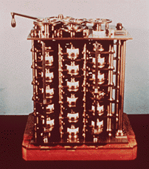
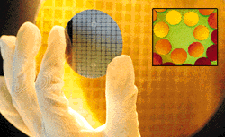
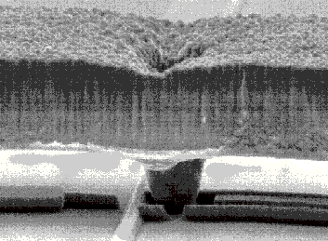
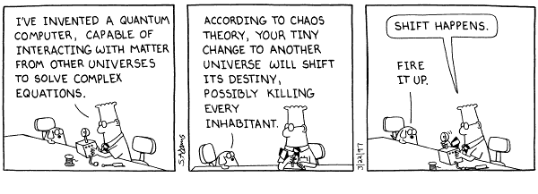
Motivation
1m
.1nm

Slide 3
Outline
The one-time pad: classical and quantum
Argument from measure concentration
Superdense coding: from bits to qubits
Reduction to Dvoretzky
(Almost Euclidean subspaces of Schatten l_{p})
More one-time pad:
Exponential (and more) reduction in key size
Decomposing l₁(l₂) into a direct sum of almost Euclidean subspaces

Slide 4
One-time pad
Message
Shared key
1 bit of key per bit of message necessary and sufficient [Shannon49]

Slide 5
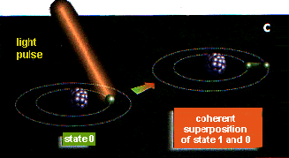
Sets are to information as…
Light pulse
Superposition:
States 0 and 1
State 0
|1i|0i
|1i
|0i+|1i
|0i|1i
|0i
|1i|1i ?
|0i|0i
One qubit:
C²
Two qubits:
C² ­ C²
(Unit) Vectors are to
quantum information.

Slide 6
Distinguishability

Slide 7
Physical operations…
Are unitary:
They preserve inner products

Slide 8
Physical operations…
Are unitary:
They preserve inner products

Slide 9
One-time pad
Message
Shared key
1 bit of key per bit of message necessary and sufficient [Shannon49]

Slide 10
Quantum one-time pad
Message
Shared key
Minimal key length: k = 2n

Slide 11
Approximate quantum one-time pad
ε-approximate security criterion:
Can achieve using n+log(1/ε²) bits of key
Reduction of factor 2 over exact security
Proof:
Select {U_{j}} i.i.d. according to Haar measure on U(2^{n})
Use net on set of {X}
[H-Leung-Shor-Winter 03]

Slide 12
Approximate encryption: More later…

Slide 13
Measuring entanglement
Entanglement: nonlocal content of a quantum state (normalized vector)
Maximally
entangled
vector
Product
vector

Slide 14
Dvoretzky’s theorem à la Milman
Maximally
Entangled
Product
For p approaching 1, subspace S is all but constant number of qubits.
[Hayden-Leung-Winter 06, Aubrun-Szarek-Werner 10]

Slide 15
Superdense coding
j 2 {0,1,2,3}
Time
σ_{j}
1 qubit
|Φ₀i = |00i_{AB} + |11i_{AB}
1 ebit
Bob receives one of four orthogonal (distinguishable!) states depending on Alice’s action
1 ebit + 1 qubit ≥ 2 cbits
[Bennett-Wiesner 92]

Slide 16
Superdense coding of arbitrary quantum states
Suppose that Alice can send Bob an arbitrary 2 qubit state by
sharing an ebit and physically transmitting 1 qubit.
1 qubit + 1 ebit ≥ 2 qubits
2 qubits + 2 ebits ≥ 4 qubits
Substitute: (1 qubit + 1 ebit) + 2 ebits ≥ 4 qubits
1 qubit + 3 ebits ≥ 4 qubits
Repeat: 1 qubit + (2^{k}-1) ebits ≥ 2^{k} qubits

Slide 17
Superdense coding of maximally entangled states
Time
1 qubit
|Φ₀i = |00i_{AB} + |11i_{AB}
1 ebit
Alice can send Bob any maximally entangled pair of qubits
by sharing an ebit and physically transmitting a qubit.

Slide 18
Superdense coding of maximally entangled states
Time
log(a) qubits
log(a) ebits
2 log(a) qubits
Alice can send Bob and maximally entangled pair of qubits
by sharing an ebit and physically transmitted a qubit.

Slide 19
Superdense coding of arbitrary quantum states
log(a)+const qubits
log(a) ebits
2 log(a)-const qubits
Asymptotically, Alice can send Bob an arbitrary 2 qubit state by
sharing an ebit and physically transmitting 1 qubit.
1 qubit + 1 ebit ≥ 2 qubits

Slide 20
Approximate quantum one-time pad from superdense coding
log(a)+const qubits
log(a) ebits
Time-reverse!
2 log(a)-const qubits
Asymptotically, Alice and send Bob an arbitrary 2 qubit state by
sharing an ebit and physically transmitting 1 qubit.

Slide 21
Approximate quantum one-time pad from superdense coding
log(a)+const qubits
Time-reverse!
log(a) ebits
2 log(a)-const qubits
Asymptotically, Alice and send Bob an arbitrary 2 qubit state by
sharing an ebit and physically transmitting 1 qubit.
{U_{j}} forms a perfect quantum one-time pad:
Total key required is 2 x ( log(a) + const ).

Slide 22
Encrypting classical bits in quantum states
Secret key
Strongest security: for any pair of messages x₁ and x₂, Eve cannot
distinguish the encrypted x₁ from the encrypted x₂. (TV ≤ δ)
Less strong security: Assume x uniformly distributed. Eve uses
Bayes’ rule to calculate p(x|measurement outcome).
TV from uniform ≤ δ for all measurements and outcomes.

Slide 23
Encrypting classical bits in quantum states
Secret key
Less strong security: Assume x uniformly distributed. Eve uses
Bayes’ rule to calculate p(x|measurement outcome).
TV from uniform ≤ δ for all measurements and outcomes.
Colossal key reduction: Can take k = O(log 1/δ).
Proof: Choose {U_{j}} i.i.d. using Haar measure, no ancilla.
Adversarial argument for all measurements complicated.
[HLSW03],
[Dupuis-H-Leung10],
[Fawzi-H-Sen10]

Slide 24
Quantum encryption of cbits: Connection to l₁(l₂)
Each V_{k} gives a low-distortion embedding of l₂ into l₁(l₂).
C
A
uniform
D
B
Secret key j
Quantum one-time pad
Proof that this works is an easy calculation. (Really!)
[Fawzi-
H-Sen 10]
Leads to key size O(log 1/ε) with ancilla of size O(log n + log 1/ε)

Slide 25
Explicit constructions!
Adapt [Indyk07] construction of l₂ into l₁(l₂) to produce a quantum algorithm for the encoding and decoding.
Recursively applies mutually unbiased bases and extractors.
Build Indyk embedding from an explicit sequence of 2-qubit unitaries.
Procedure uses number of gates polynomial in number of bits n. (Indyk algorithm runs in time exp(O(n)).)
Get key size O(log²(n)+log(n)log(1/ε)).
Also gives efficient constructions of:
Bases violating strong entropic uncertainty relations
Efficient protocols for string commitment
Efficient encoding for quantum identification over cbit channels

Slide 26
Summary
Basic problems in quantum information theory can be interpreted as norm embedding problems:
Approximate quantum one-time pad
Existence of highly entangled subspaces
Quantum encryption of classical data
Additivity conjecture! (Not even mentioned)
Formulating problems this way simplifies proofs and allows application of known explicit constructions

Slide 27
Open problems
Explicit constructions for embedding l₂ into Schatten l_{p}?
Why do all these results boil down to variations on Dvoretzky?
What other great theorems should quantum information theorists know?

